Slide 2
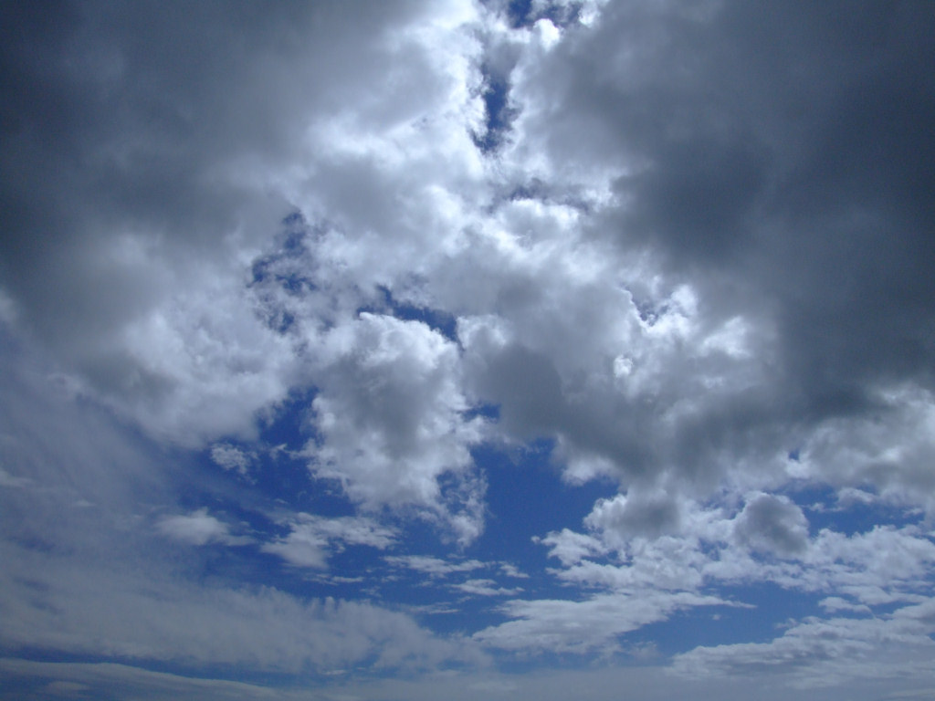

Slide 3
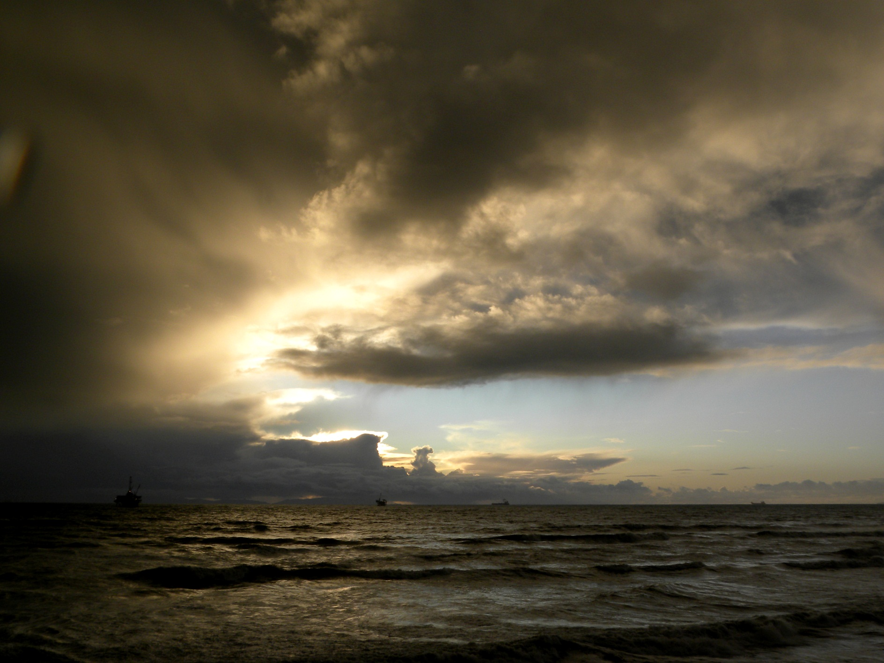

Slide 4
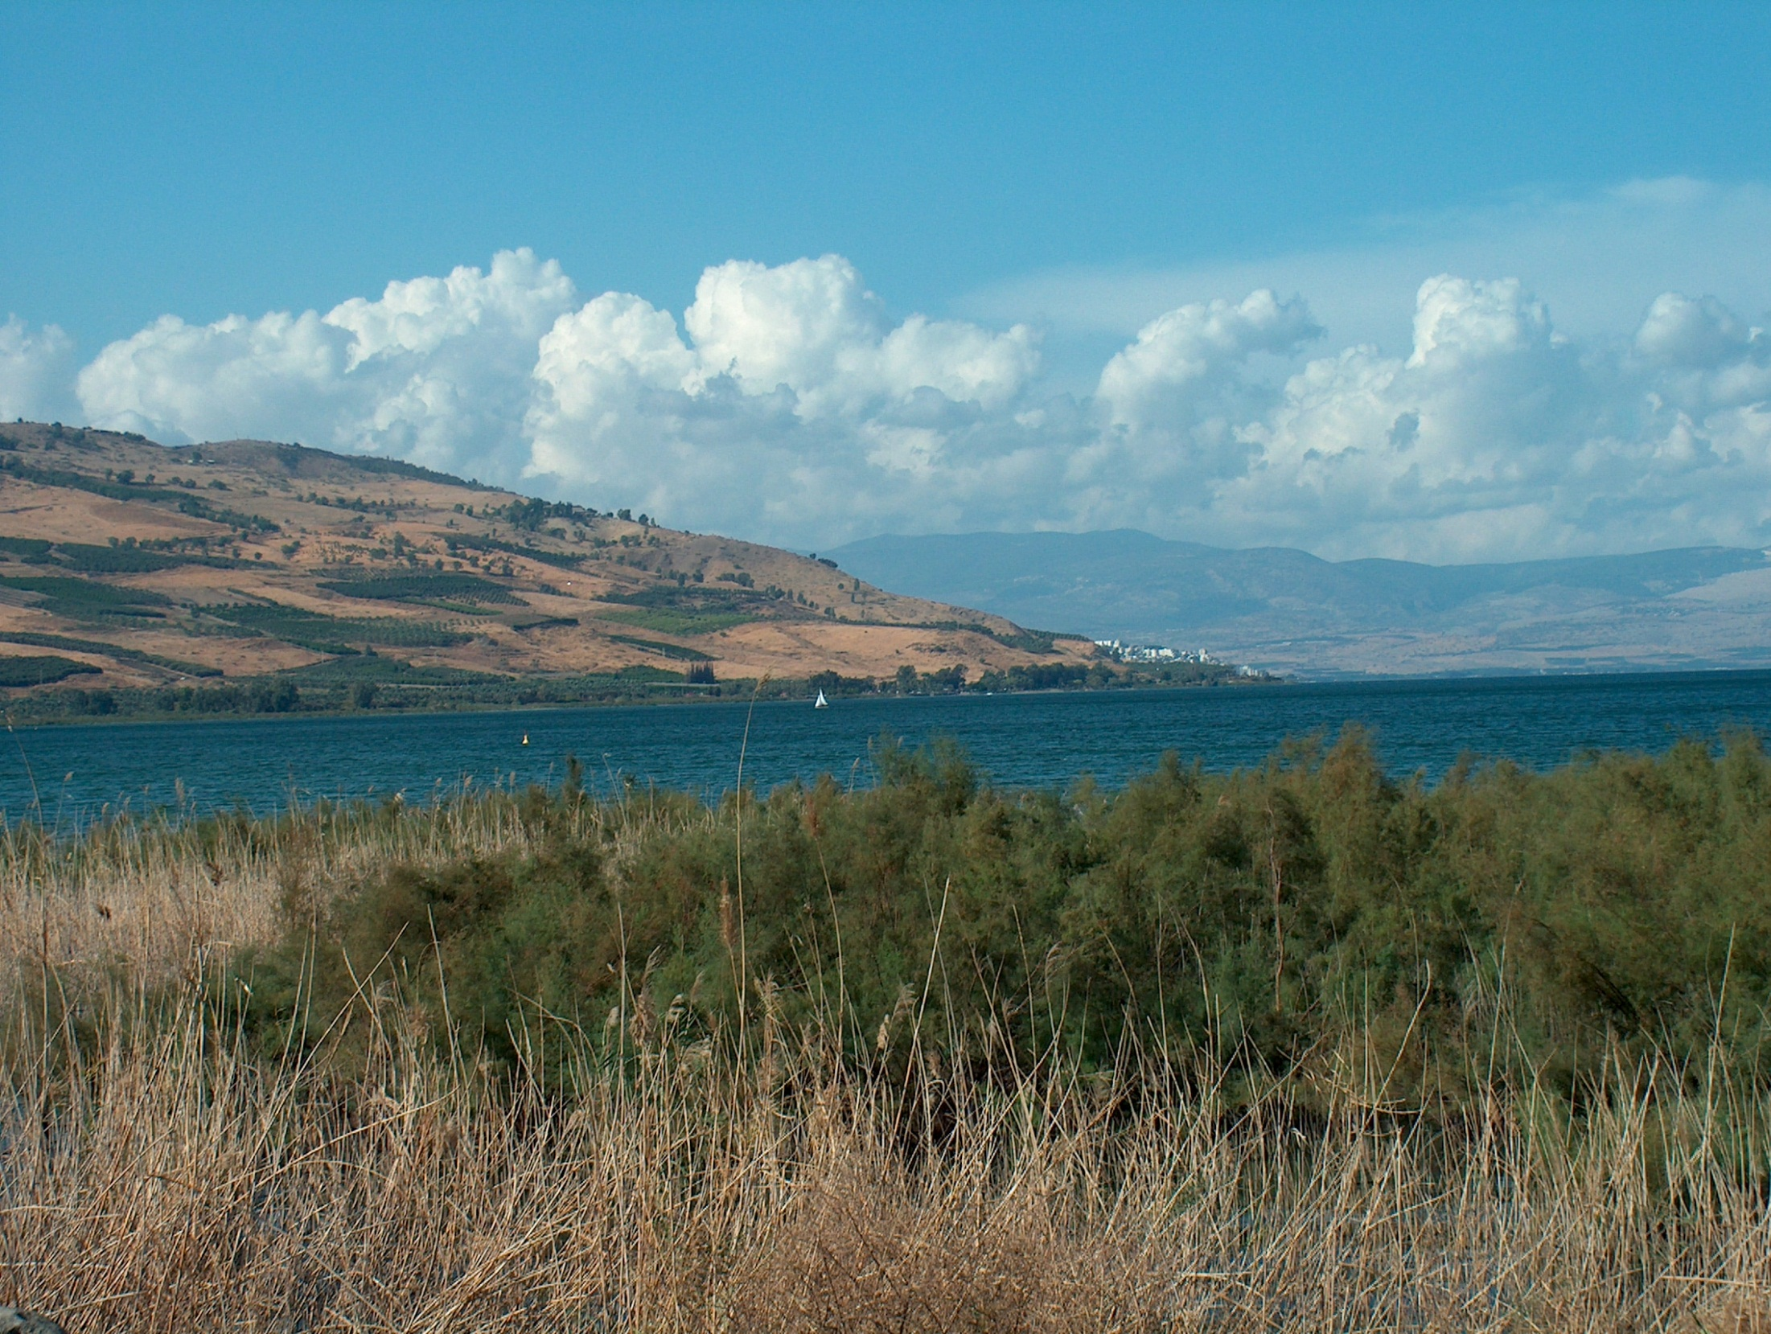

Slide 5
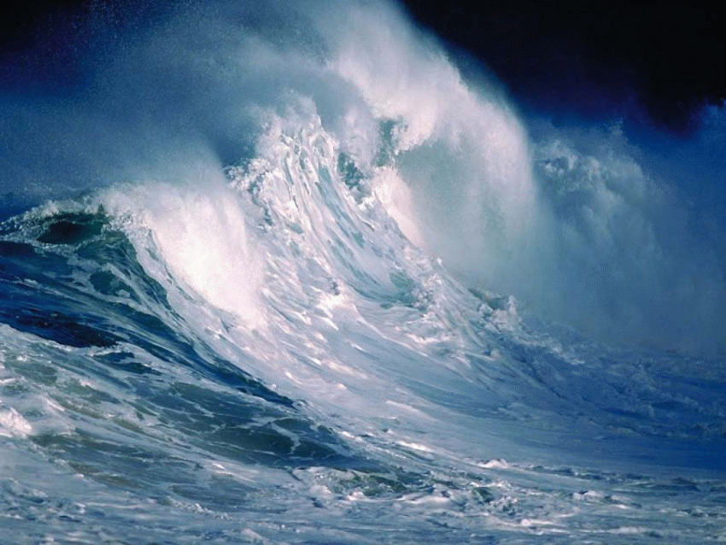

Slide 6
The disciples went and woke him up, shouting, “Lord, save us! We’re going to drown!”
Jesus responded, “Why are you afraid? You have so little faith!”
Then he got up and rebuked the wind and waves, and suddenly there was a great calm.
The disciples were amazed. “Who is this man?” they asked. “Even the winds and waves obey him!”
(Matthew 8:25-27, NLT)

Slide 8
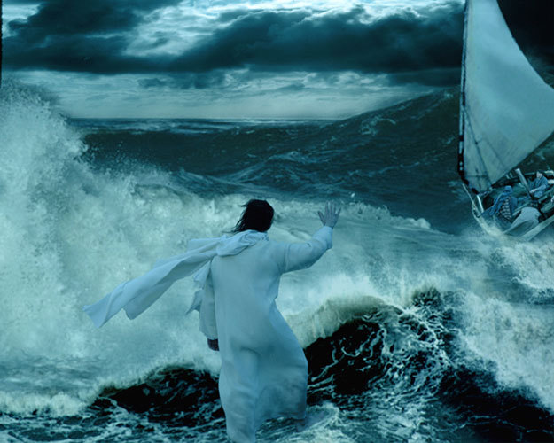

Slide 9
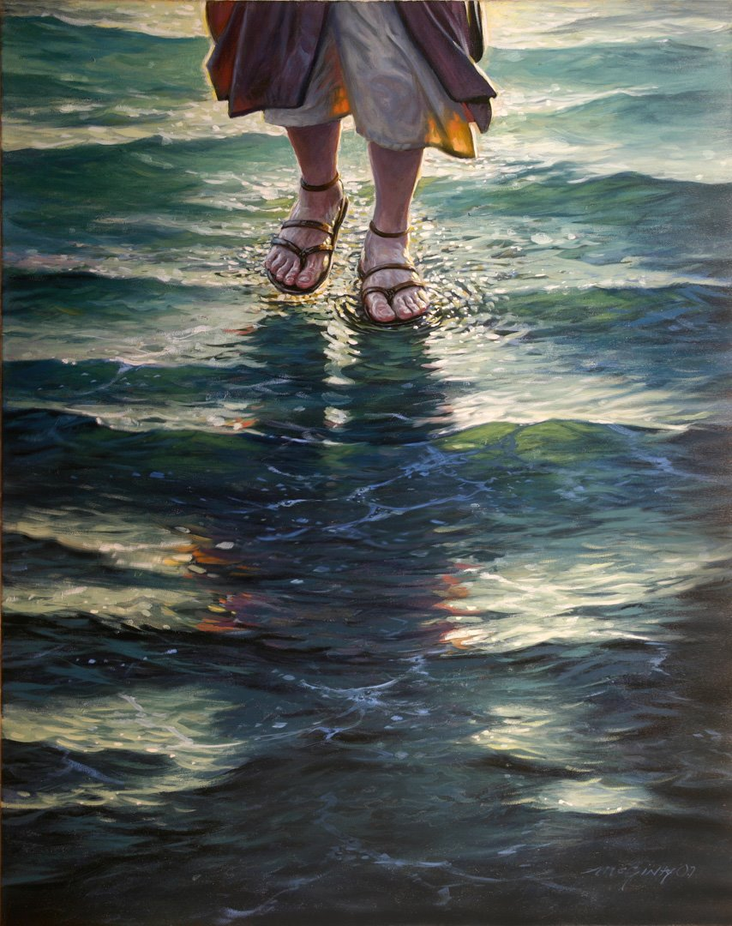

Slide 10
“Jesus immediately reached out and grabbed him.
‘You don’t have much faith,’ Jesus said. ‘Why did you doubt me?’
When they climbed back into the boat, the wind stopped.
Then the disciples worshiped him. ‘You really are the Son of God!’ they exclaimed.”
(Matthew 14:31-33, NLT)

Slide 11
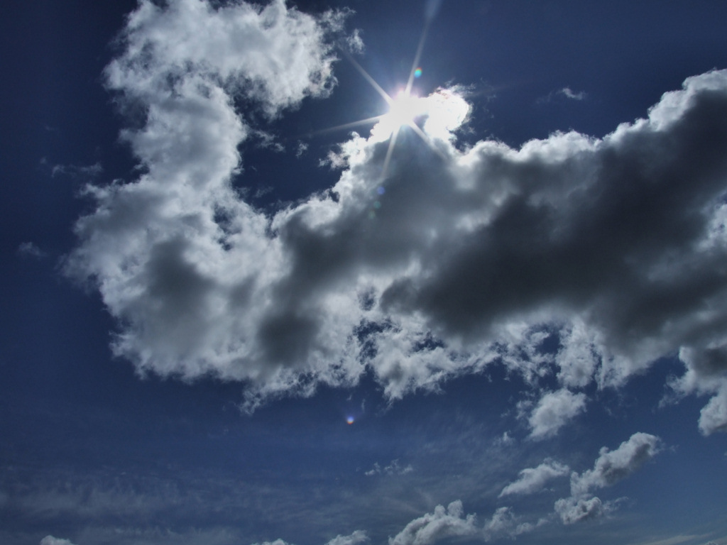
Big difficulties are perfect opportunities to trust God boldly and grow in faith which pleases Him.

Slide 12
